Slide 1
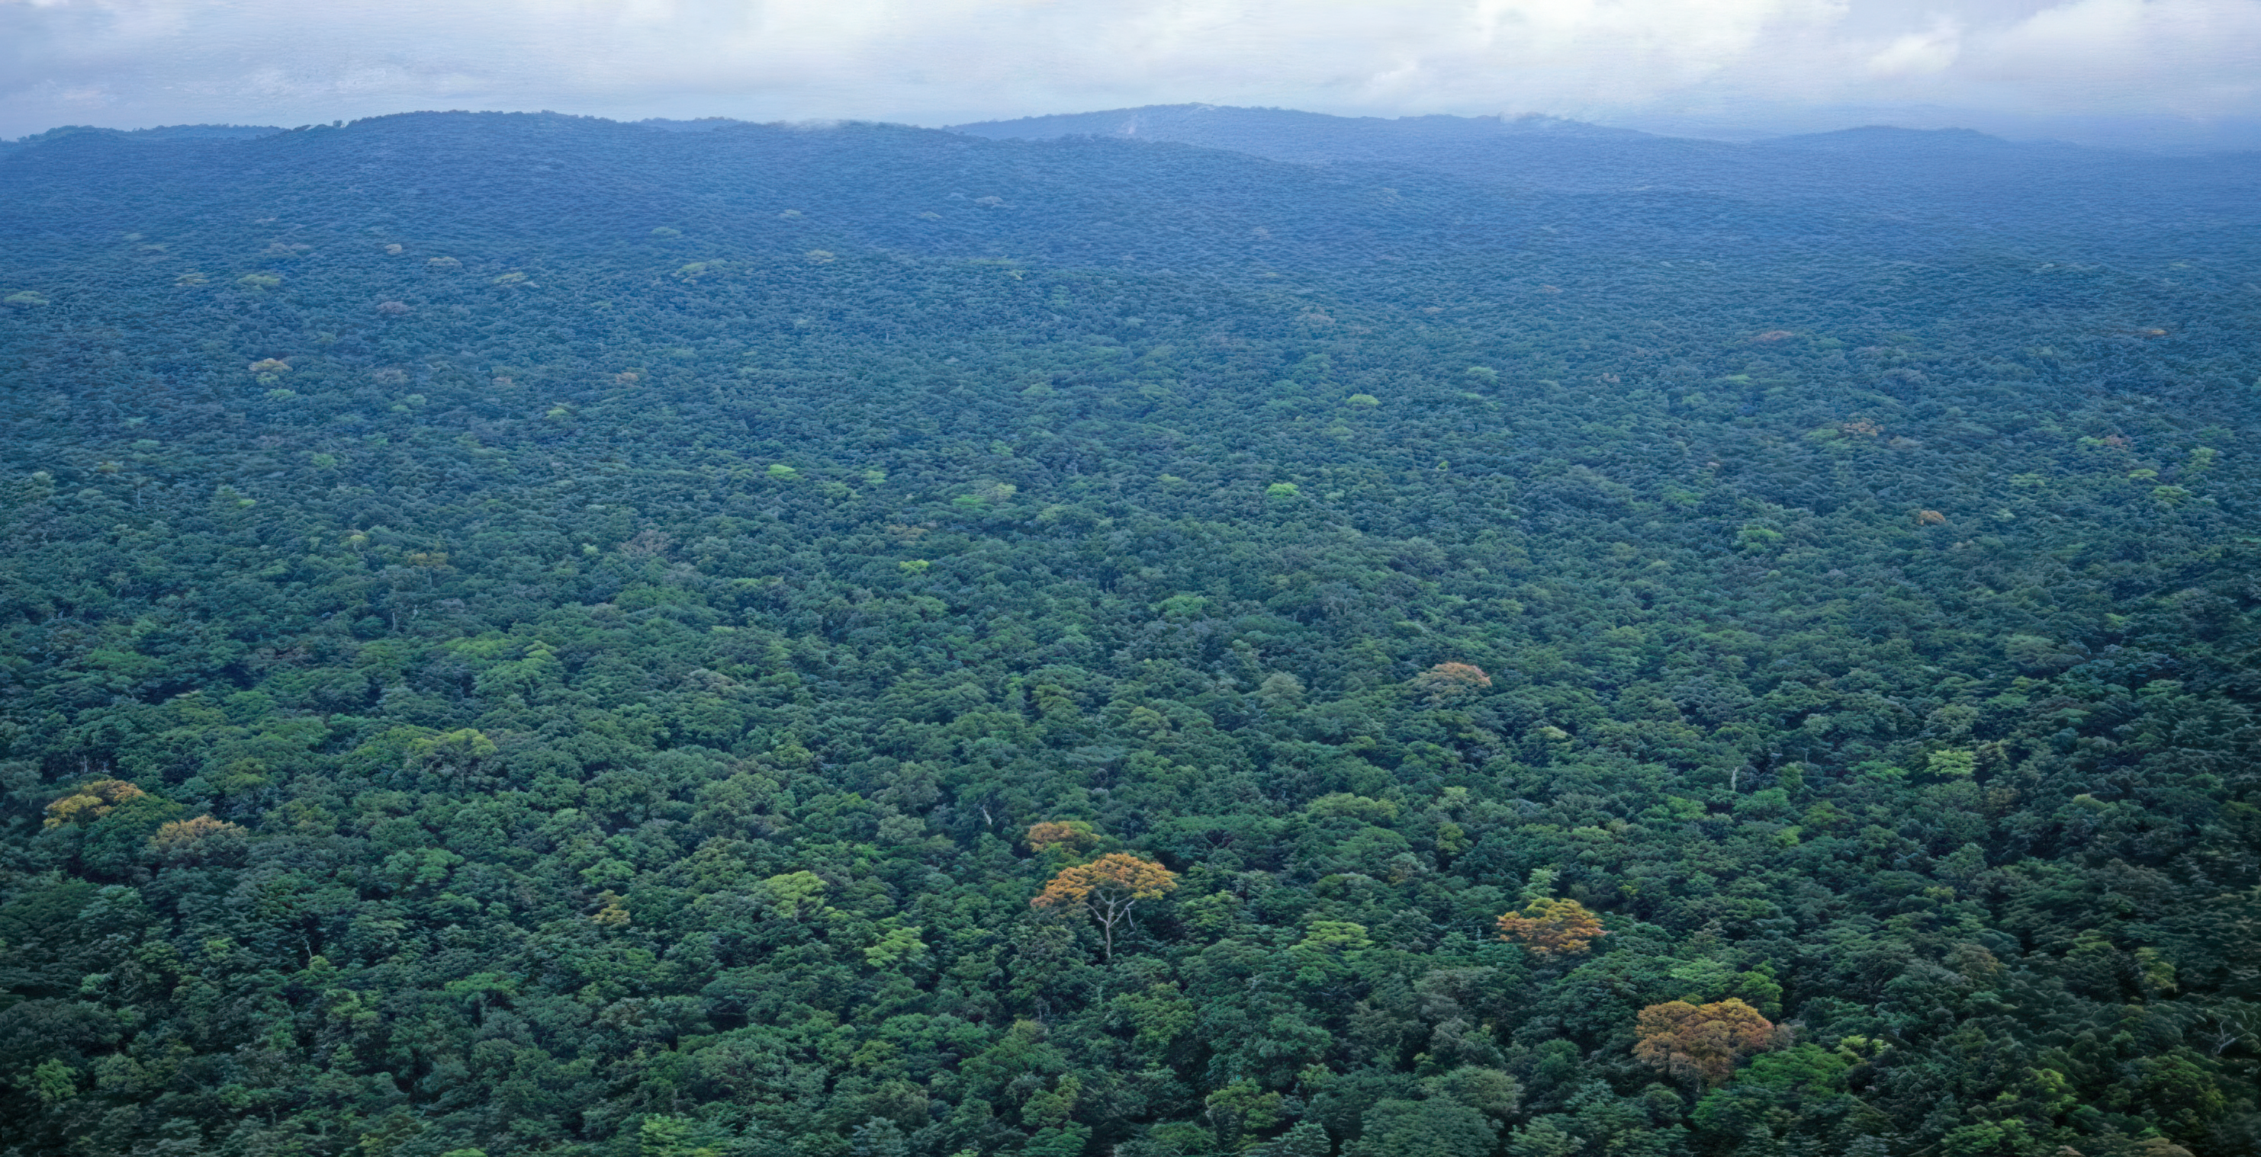
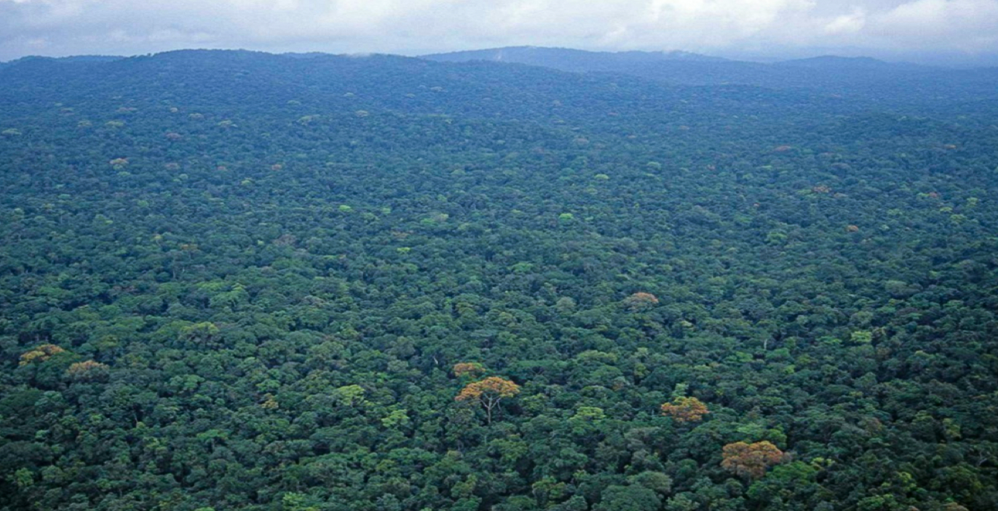










NATIONAL FOREST FORUM (NFF)
Presentation on the Liberia Conservation Sector 2023- Present
Presented by: Michael F. Garbo-Executive Director/SCNL
on behalf of the Conservation NGOs
3rd-5th November 2025

Slide 2
Presentation Outline
Conservation programs/interventions
Successes/achievements
Key challenges
Solutions/Recommendations
Opportunities
Alignment with the AAID

Slide 3
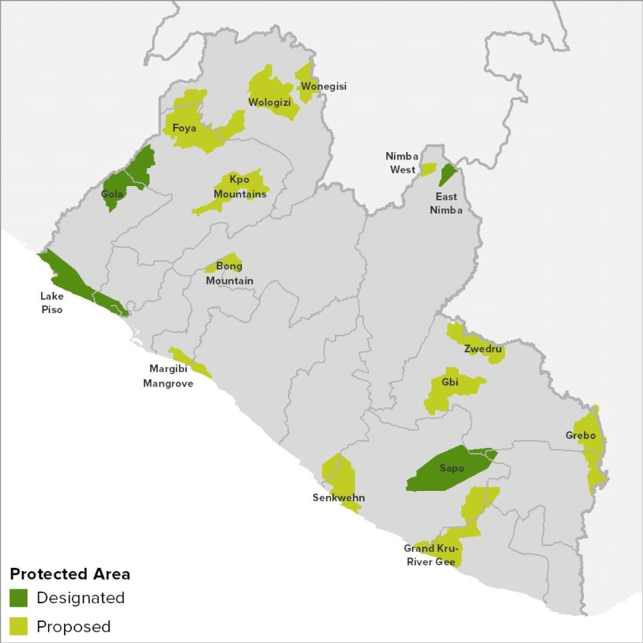
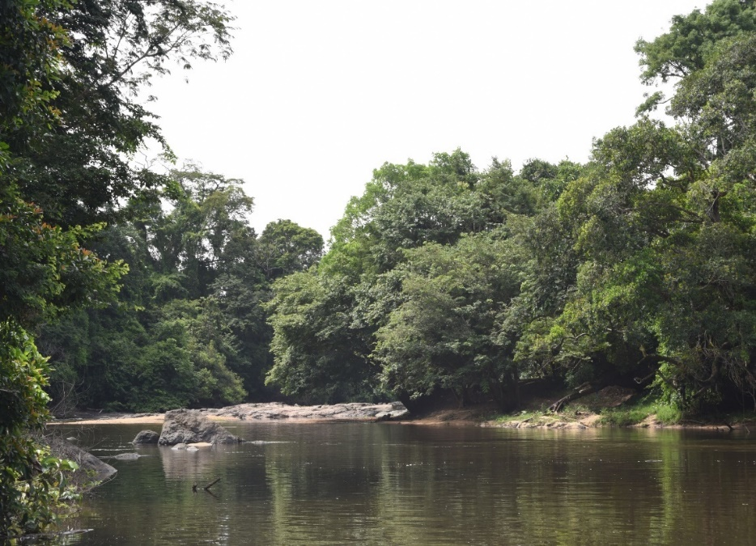
Conservation programs/interventions
PAs Establishment/management (Eg. Parks, OECMs)
Ecotourism
Capacity-building
Customary Land Formalization (CLF)
Livelihoods (eg. Agroforestry/Sustainable Agriculture/VSLA/enterprise development, etc)
Transboundary Landscape Management
Supporting Government law/policy reforms

Slide 4
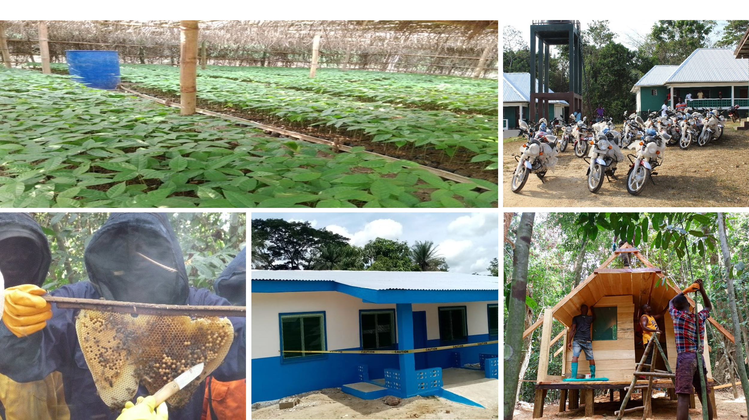
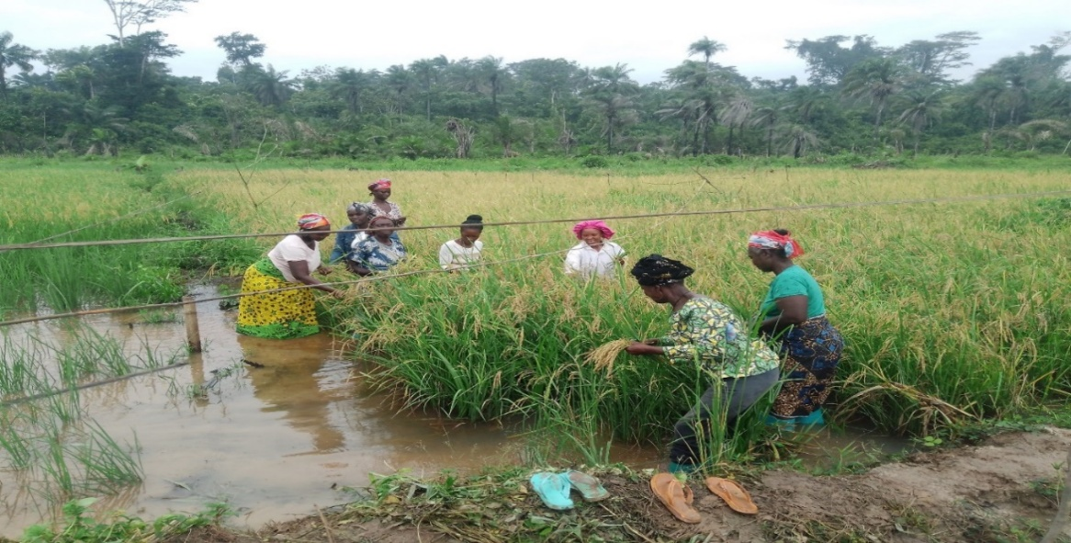
Successes/achievements
Legal frameworks (NWCPAML, NFRL)
Existing framework for Long-term Conservation Fund (LCF)
Revolving funds in circulation that improve local economies ($89,9293)
Increased women’s participation in forest management (Rangers, Ecoguards, Park wardens, and Chief Officers)
CCA framework & investment ($585,844)
Partnered with GoL to gazette 5 out of 11 PPAs’
690,000 hectares of community Forests under improved management

Slide 5
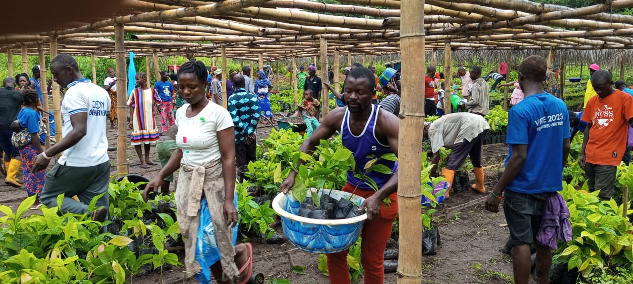
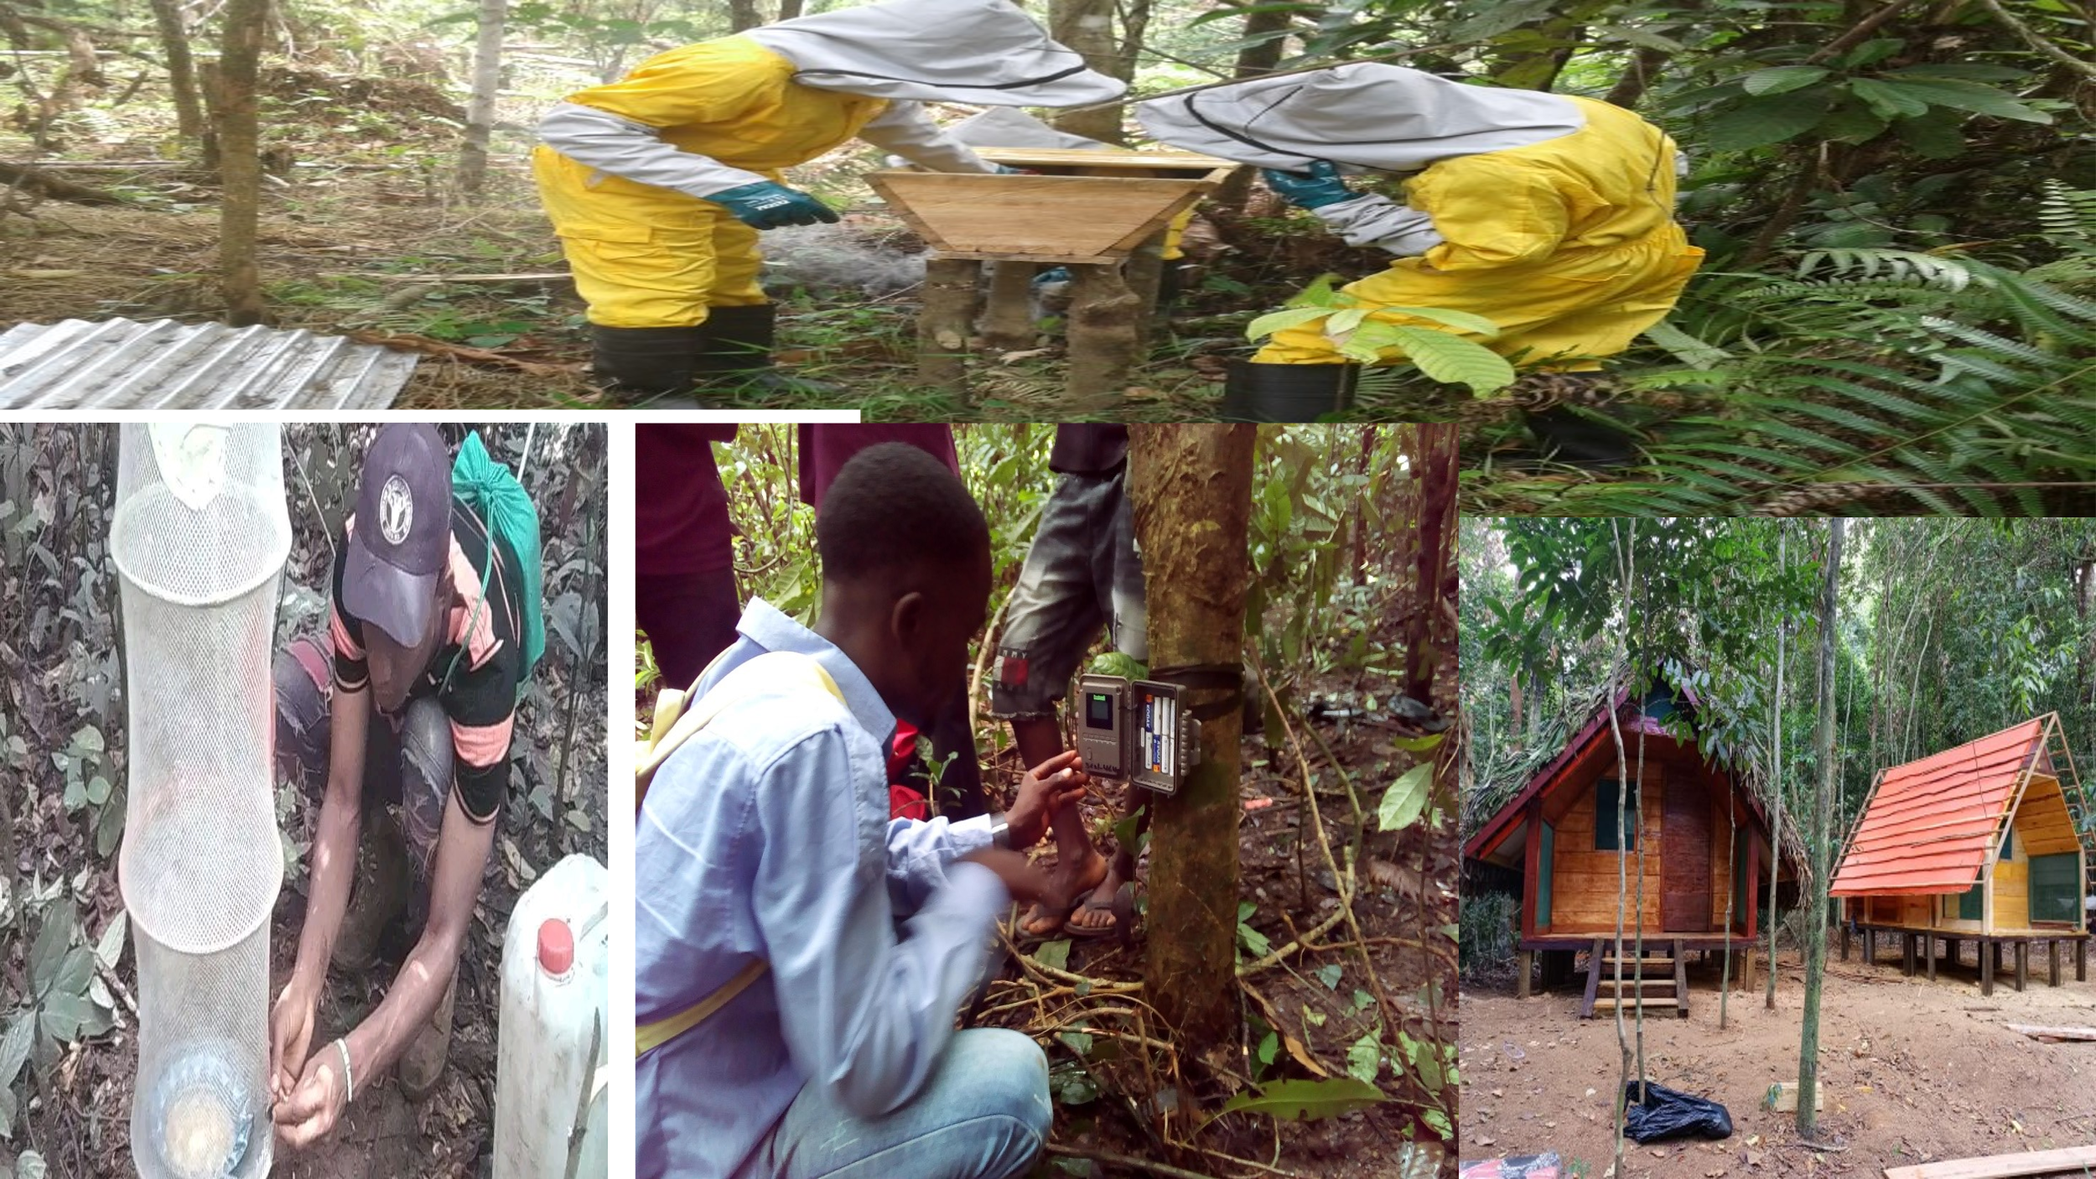
Successes/achievements
89,902 hectares under Restoration
3,856 employment (communities, ecoguards, staff, others)
98 key capacity-building offered (eg. BSc, MSc, specialized trainings, etc.)
Supporting AAID Pillar ii & v, NBSAP, CBD, UNFCCC, 30x30, NDC, etc
Supporting Government policy reforms ( Eg. Amended Wildlife law, Carbon Policy)
Transboundary Conservation/Peacebuilding

Slide 6
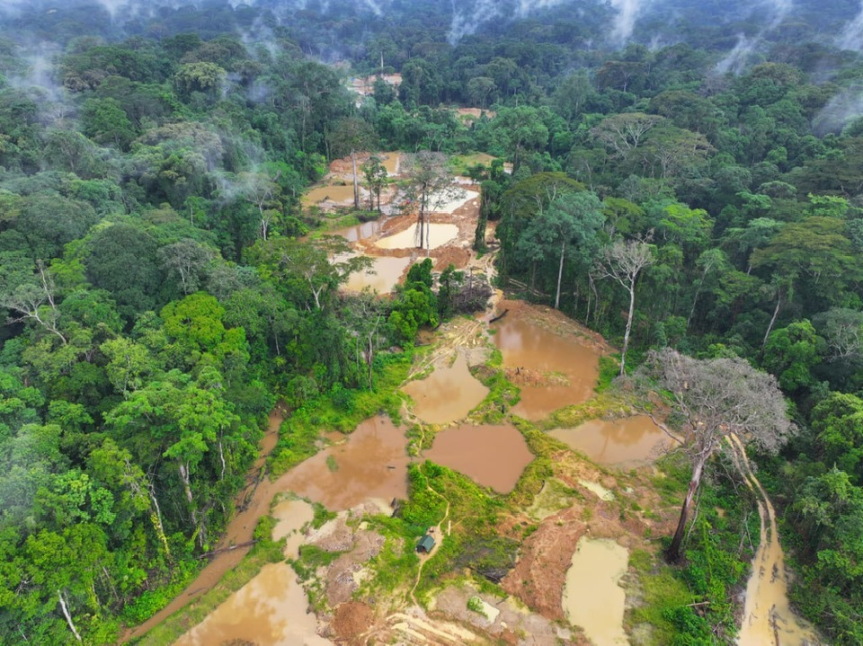
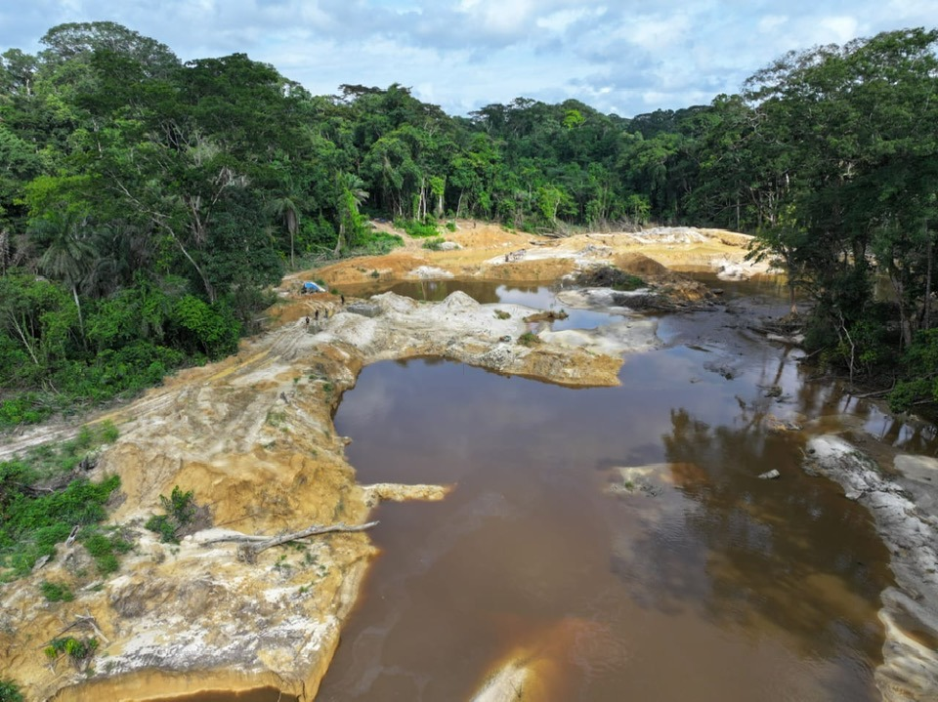
Key Challenges
Competing priorities & Limited Inter-agency coordination/collaboration (Eg. FDA, EPA, MME, LLA, MoA)
Lack of an integrated national land-use plan
Minimum funding from GoL for sustainable forest management
Influx of illegal foreign miners and farmers in the Priority Forest Landscapes
Delay in the amendment of the NWCPML
Lack of a centralized database for Conservation interventions in priority landscapes
Limited sustainable financing for PAs & OECMs
Weak collaboration on transboundary wildlife crimes
Limited private sector investment in biodiversity credit, offset, and climate finance
Lack of a benefit-sharing mechanism for conservation

Slide 7
Solutions/Recommendations
Strengthen Inter-agency coordination/collaboration (Eg, FDA, EPA, MME, LLA, MoA)
Develop a National Framework leading to the development of an integrated national land-use plan that considers all the major sectors
Increase national budgetary support
Strengthen border security & national action plan to address the current influx
Immediate action needed for the amendment of the National Wildlife & PA management law
Need for an integrated approach to conservation (conservation, WASH, Infrastructure, etc)
Develop an integrated centralized database
Develop SOP on transboundary wildlife crimes
Need for an engagement framework for private sector investment in biodiversity credits, offsets, and climate finance
Conduct Opportunities Assessment before PA creation in Priority Landscapes

Slide 8
Opportunities
Highest intact forest complex in West Africa 6.605 million hectares (NFI, 2018)
Increased partnership with Donor institutions & access to funding mechanism
Ecotourism potential
Climate Finance & REDD+/Carbon, Sustainable Finance
Tropical Forest Forever Facility (TFFF)
Frameworks and implementation of CLF & FPIC
Awareness & Education are the foundation for stakeholders’ participation and ownership

Slide 9














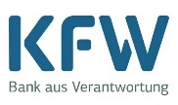

Donor Partners
Total funds mobilized for conservation
(2023-current)
$60,264,523

Slide 10

THANK YOU!

